Slide 2
CHAPTER 22
Documenting an Architecture

Slide 3
Documentation is a love letter that you write to your future self.
—Damian Conway

Slide 4
Chapter Outline
Introduction
Audiences for Architecture Documentation
Notations
Views
Module Views
C&C Views
Allocation Views
Quality Views
Combining Views
Documenting Behavior
Trace-Oriented Notation
Comprehensive Behavior Notation
Summary

Slide 5
Introduction
Creating an architecture isn’t enough.
Documentation speaks for the architect.
It speaks for the architect today, when the architect should be doing other things besides answering a hundred questions about the architecture.
And it speaks for the architect tomorrow, who has forgotten the details of what the architecture includes, or when that person has left the project and someone else is now the architect.

Slide 6
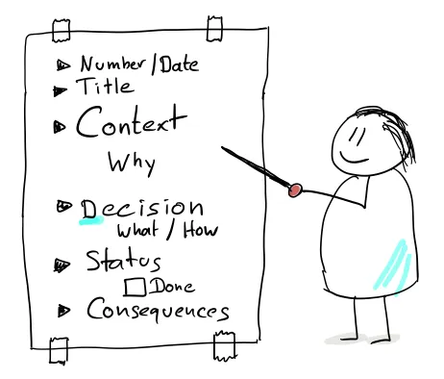
Introduction
Documentation also serves as the receptacle to hold the results of major design decisions as they are confirmed.
don’t think of documentation as a step that is distinct from and follows design.
Design and documentation are, ideally, the same piece of work.

Slide 7
Audiences for Architecture Documentation
Many different kinds of people will have an interest in architecture documentation.
Understanding the uses of architecture documentation is essential, as those uses determine what information to capture.
Architecture documentation has four uses:
As a mean of education
For introducing people new members of the team to the system.
For presenting your solution for the first time to a customer.
For communication among stakeholders

Slide 8
Audiences for Architecture Documentation
The basis for system analysis and construction
Architecture tells implementers which modules to implement and how those modules are wired together.
The basis for forensics when an incident occurs
When an incident occurs, someone is responsible for tracking down cause of the incident and immediate information about the flow of control will be helpful.
For example, information of interface specifications will provide context for the flow of control.
And component descriptions will indicate what should have happened in each component on the trace of events.

Slide 9
Notations
Notations for documenting views differ considerably in their degree of formality. Roughly speaking, there are three main categories of notation:
Informal notations
Most box-and-line drawings you’ve probably seen fall into this category
Like Power Point or some similar tool, or hand-drawn sketches on a whiteboard.
The description are in natural language, and cannot be formally analyzed.
Semiformal notations
Views may be expressed in a standardized notation that prescribes graphical elements and rules of construction, but does not provide a complete semantic treatment of the meaning of those elements.
UML and its system engineering adjunct SysML are semiformal notations.

Slide 10
Notations
Formal notations
Views may be described in a notation that has a precise (usually mathematically based) semantics.
Formal analysis of both syntax and semantics is possible.
A variety of formal notations for software architecture are available. Generally referred to as architecture description languages (ADLs)
The usefulness of ADLs lies in supporting automation through associated tools like analysis or code generation.
In practice, the use of formal notations is rare.
Typically, more formal notations take more effort to create and understand, but repay this effort with reduced ambiguity and more opportunities for analysis.

Slide 11
Views
A software architecture is a complex entity that cannot be described in a simple one-dimensional fashion.
A view is a representation of a set of system elements and relations among them. (not all system elements, but those of a particular type.)
For example, a layered view of a system would show elements of type “layer”; that is, it would show the system’s decomposition into layers, along with the relations among those layers.
A pure layered view would not show the system’s services, or clients and servers, or data model, etc.
Thus, views let us divide a multidimensional entity like software architecture, into a number of representations of the system.

Slide 12
Views
Documenting an architecture is a matter of documenting the relevant views and then adding documentation that applies to more than one view.
Different views expose different quality attributes to different degrees.
The views you should document depend on the uses you expect to make of the documentation.
Each view has a cost and a benefit, and you should ensure that the expected benefits outweigh the costs.
Module views, C&C views, and allocation views are the appropriate mechanism for representing different design patterns.
The choice and number of views should be guided by the documentation's intended purpose, quality concerns, and architectural patterns.

Slide 13
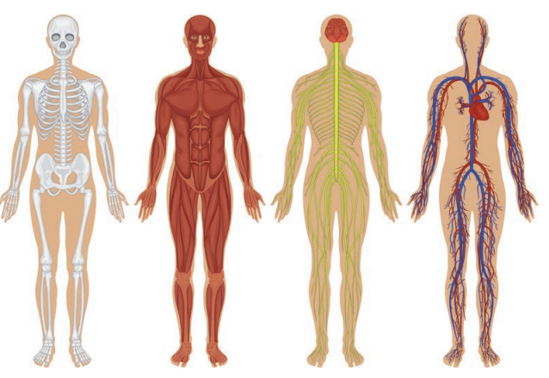
View is about seeing a complex system in several simpler figures

Slide 14
Module Views
A module is a part of the system that handles a clear set of tasks. It can be a class, a group of classes, a layer, or other code structures. Modules are shown in views like decomposition, uses, or layers.
Each module has properties, such as its responsibilities, who can access it, and its change history. Modules can relate to each other in different ways, like is-part-of, depends-on, and is-a.
Module views document static structures and help with understanding code structure, planning work, and ensuring modifiability.
The documentation of any software architecture is unlikely to be complete without at least one module view.

Slide 15
Module Views
Properties of module that help with building and understanding the system should be written down in the documentation for that module. Like:
Name: Identifies the module, often shows its role and position.
Responsibilities: Describes what the module does in detail.
Implementation info: Includes code files, tests, constraints, and links to test plans.
Source code mapping: Which files make up the module
Test information: Test plans, cases, and tools, or at least where to find them.
Management info: Expected schedule and budget, or a reference to where this info is stored.
Constraints: Any rules or strategies that must be followed during implementation.
Revision history: Tracks who changed what and when, useful for maintenance.

Slide 16
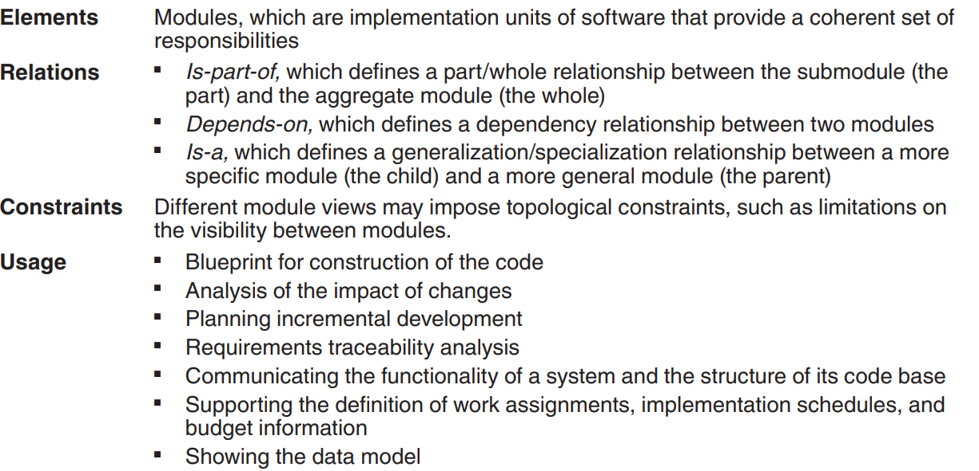
The above picture summarizes the characteristics of module views.

Slide 17
C&C Views
C&C views describe the runtime structure of a system by showing its components (e.g., processes, services, clients, servers, data stores) and how they interact through connectors (e.g., message queues, service calls, event broadcasts).
The main relationship in C&C views is attachment, which connects components and connectors. The system is seen as a graph of these connections. For the system to work properly, connected elements must be compatible (e.g., matching data types or encryption expectations).
Uses of C&C Views:
Help developers and stakeholders understand how the system behaves at runtime
Enable performance and quality analysis, like predicting latency, reliability, or identifying bottlenecks.
Allow animation or walkthroughs of activities across components

Slide 18
C&C Views
Every component or connector should have a name, type, and may include additional properties to support analysis:
Reliability: Likelihood of failure
Performance: Response times, bandwidth, latency
Resource Requirements: Processing, memory, energy needs
Functionality: What tasks it performs
Security: Encryption, authentication, etc.
Concurrency: Thread or process execution
Runtime Extensibility: Ability to handle evolving message types

Slide 19
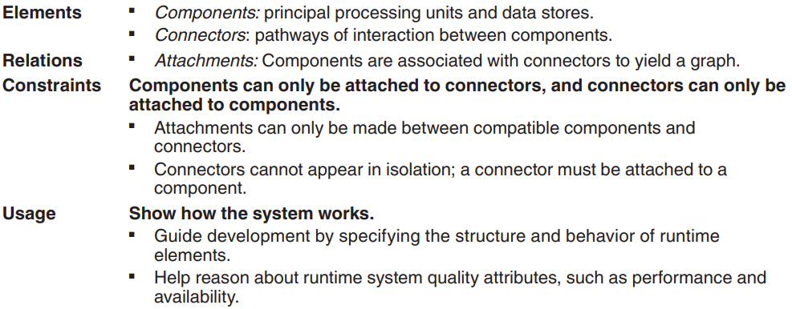
Summary of C&C Views

Slide 20
Allocation Views
Allocation views describe how software elements are mapped to environmental elements such as hardware, operating systems, files, or teams.
The software elements come from a module or C&C view.
The relation in an allocation view is allocated-to.
A single software element can be allocated to multiple environmental elements, and multiple software elements can be allocated to a single environmental element.
Software elements and environmental elements have properties in allocation views.

Slide 21
Allocation Views
With allocation view you can check if the software's needs (like memory, speed, or security) match what the hardware or environment can provide.
Allocation views can depict either static or dynamic views.
A static view illustrates a fixed allocation of resources in an environment.
A dynamic view shows the conditions and the triggers for which allocation of resources changes.
For example, a load-balancing system might create new processes or threads on another machine to handle more work and keep performance steady.

Slide 22
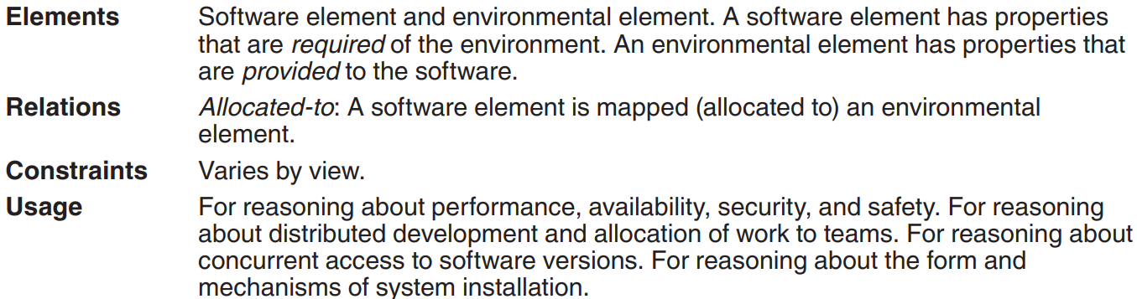
Summary of C&C Views

Slide 23
Quality Views
Structural views help with building the system, but when quality aspects like performance or security are very important, special views focused on those qualities may explain the design choices more clearly.
Module, C&C, and allocation views are all structural views: They primarily show the structures that the architect has designed into the architecture to satisfy functional and quality attribute requirements.
Quality views are formed by extracting the relevant pieces of structural views and packaging them together.

Slide 24
Quality Views: Examples
Security view: Shows architectural security measures, involved components, communication paths, repositories, protocols, and responses to threats.
Communications view: Shows component-to-component channels, network channels, quality-of-service parameters, and areas of concurrency.
Exception/Error-handling view: Shows how components detect, report, and resolve errors, and supports root-cause analysis.
Reliability view: Models mechanisms such as replication, switchover, timing issues, and transaction integrity.
Performance view: Includes models for traffic, latency, and other performance-relevant aspects.

Slide 25
Combining Views
The basic principle of documenting an architecture as a set of separate views brings a divide-and-conquer advantage to the task of documentation.
However, because all structures in an architecture are part of the same architecture and exist to achieve a common purpose, many of them have strong associations with each other.
While separate views simplify documentation, understanding the system as a whole often requires connecting or combining related views.

Slide 26
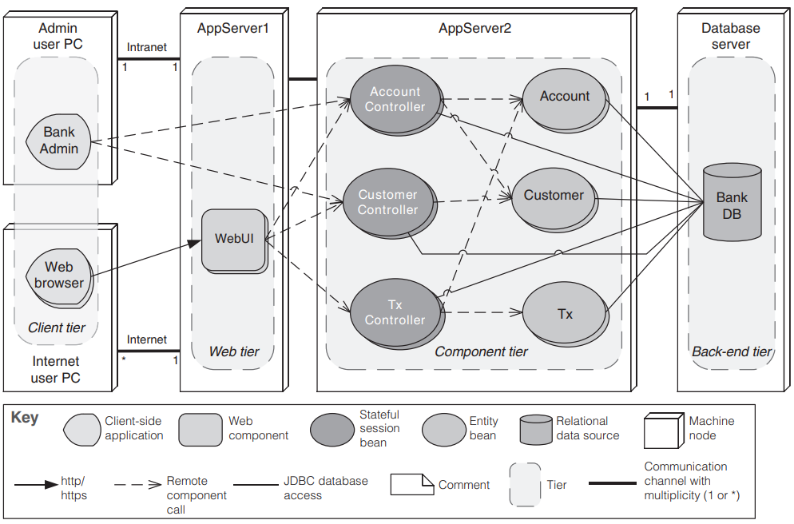
Combining Views
A combined view contains elements and relations that come from two or more other views.
This figure shows an example of a combined view that is an overlay of client-server, multi-tier, and deployment views.
This example illustrates how different perspectives can be unified to offer a holistic understanding of system architecture.

Slide 27
Documenting Behavior
Documenting an architecture requires behavior documentation that complements the structural views by describing how architecture elements interact with each other.
Reasoning about characteristics such as a system’s potential to deadlock, its ability to complete a task in the desired amount of time, or maximum memory consumption requires information about individual elements and their patterns of interaction.
Behavior documentation helps analyze how system components work together under different runtime conditions.
Two kinds of notations are available for documenting behavior: trace-oriented and comprehensive.

Slide 28
Trace-Oriented Notation
Traces are sequences of activities or interactions that describe the system’s response to a specific stimulus when the system is in a specific state.
Trace-oriented documentation does not seek to describe all possible behaviors but focuses on specific scenarios.
Four common trace-oriented notations are use cases, sequence diagrams, communication diagrams, and activity diagrams.

Slide 29
Trace-Oriented Notation
Use cases describe how actors can use a system to accomplish their goals; they are frequently used to capture the functional requirements for a system.
The description should include the use case name and brief description, primary and secondary actors, the flow of events, alternative flows, and non-success cases.
A UML sequence diagram shows a sequence of interactions among instances of elements pulled from the structural documentation.
A UML communication diagram shows a graph of interacting elements and annotates each interaction with a number denoting its order.
Communication diagrams are useful when the task is to verify that an architecture can fulfill the functional requirements.
UML activity diagrams show a business process as a sequence of steps (called actions) and include notation to express conditional branching and concurrency.

Slide 30
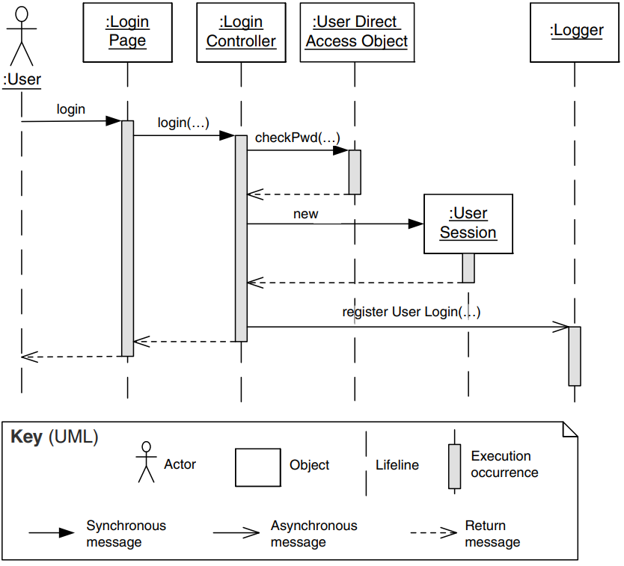
A simple example of a UML sequence diagram

Slide 31
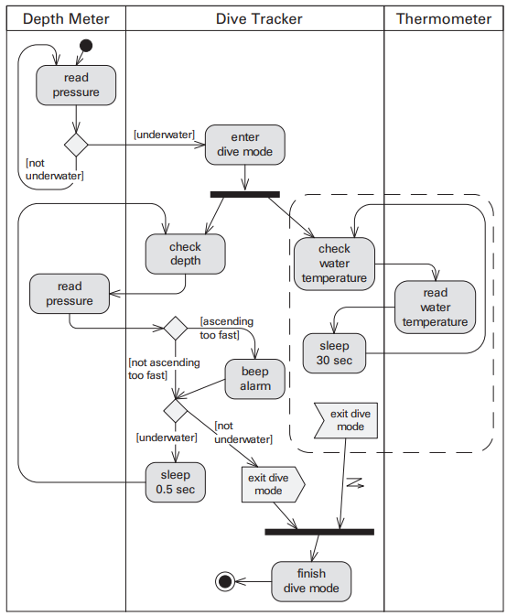
An example of activity diagram

Slide 32
Comprehensive Behavior Notation
Comprehensive notations show the complete behavior of structural elements.
Given this type of documentation, it is possible to infer all possible paths from the initial state to the final state.
State machines are a common formalism for comprehensive behavior modeling.

Slide 33
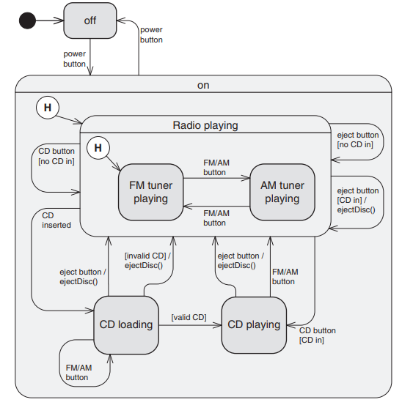
Comprehensive Behavior Notation
State machine languages complement structural descriptions with constraints on interactions and timed reactions.
UML state machine diagrams represent states using boxes and transitions using arrows.
Each transition is labeled with the event causing it and may include guard conditions and actions.
This figure is an example of a state machine diagram showing the states of a car stereo.

Slide 34
Summary
Writing architectural documentation is much like other types of writing. The golden rule is: Know your reader.
You must understand the uses to which the writing will be put and the audience for the writing.
Architectural documentation serves as a means for communication among various stakeholders.
An architecture is a complicated artifact, best expressed by focusing on particular perspectives, called views, which depend on the message to be communicated.
You must choose the views to document and choose the notation to document these views. This may involve combining various views that have a large overlap.
You must not only document the structure of the architecture but also the behavior.

